Slide 1




Al-Azhar University
Faculty of Engineering
Systems and Computer Engineering Dept.
Intelligent Systems Engineering Program
ENG 142
Digital and Logic Design (2)
Prof. Ahmed Youssef

Slide 2
Synchronous Sequential Logic Part 2

Slide 3
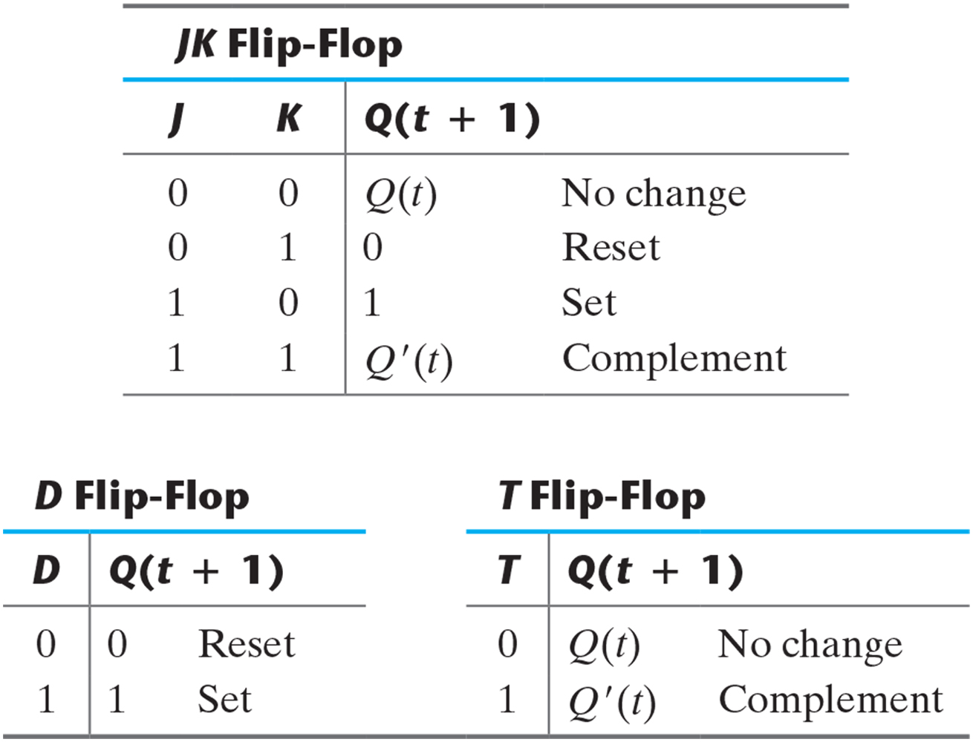
Table 5.1: Flip-Flop Characteristic Tables.
Characteristic equation
Q(t+1) = JQ’(t) + K’Q(t)
Characteristic equation
Q(t+1) = D
Characteristic equation
Q(t+1) = TQ’(t) + T’Q(t)
Q(t+1) =Q(t) ⊕ T

Slide 4
Excitation table

Slide 5
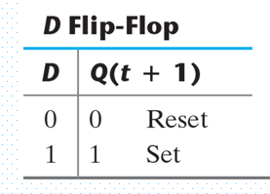
Excitation table (D f/f)
Q(t) | Q(t+1) | D
0 | 0 | 0
0 | 1 | 1
1 | 0 | 0
1 | 1 | 1

Slide 6
Excitation table (SR f/f)
S | R | Q(t+1)
0 | 0 | Q(t) | No change
0 | 1 | 0 | Reset
1 | 0 | 1 | Set
1 | 1 | ? | Undefined
Q(t) | Q(t+1) | S | R
0 | 0
0 | 1
1 | 0
1 | 1

Slide 7
Excitation table (SR f/f)
S | R | Q(t+1)
0 | 0 | Q(t) | No change
0 | 1 | 0 | Reset
1 | 0 | 1 | Set
1 | 1 | ? | Undefined
Q(t) | Q(t+1) | S | R
0 | 0 | 0 | x | NC, Reset
0 | 1 | 1 | 0 | Set
1 | 0 | 0 | 1 | Reset
1 | 1 | x | 0 | NC, Set

Slide 8
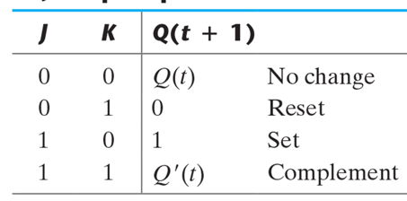
Excitation table (JK f/f)
Q(t) | Q(t+1) | J | k
0 | 0
0 | 1
1 | 0
1 | 1

Slide 9
Excitation table (JK f/f)
Q(t) | Q(t+1) | J | k
0 | 0 | 0 | x | NC, Reset
0 | 1 | 1 | x | Set, Complement
1 | 0 | x | 1 | Reset, Complement
1 | 1 | x | 0 | NC, Set

Slide 10
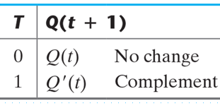
Excitation table (T f/f)
Q(t) | Q(t+1) | T
0 | 0 | 0 | NC
0 | 1 | 1 | C
1 | 0 | 1 | C
1 | 1 | 0 | NC

Slide 11
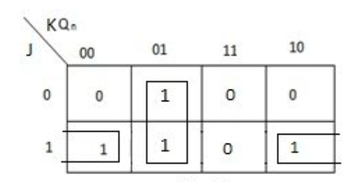
JK Flip Flop using D Flip Flop
J | K | Q(t) | Q(t+1) | D
0 | 0 | 0 | 0 | 0
0 | 0 | 1 | 1 | 1
0 | 1 | 0 | 0 | 0
0 | 1 | 1 | 0 | 0
1 | 0 | 0 | 1 | 1
1 | 0 | 1 | 1 | 1
1 | 1 | 0 | 1 | 1
1 | 1 | 1 | 0 | 0

Slide 12
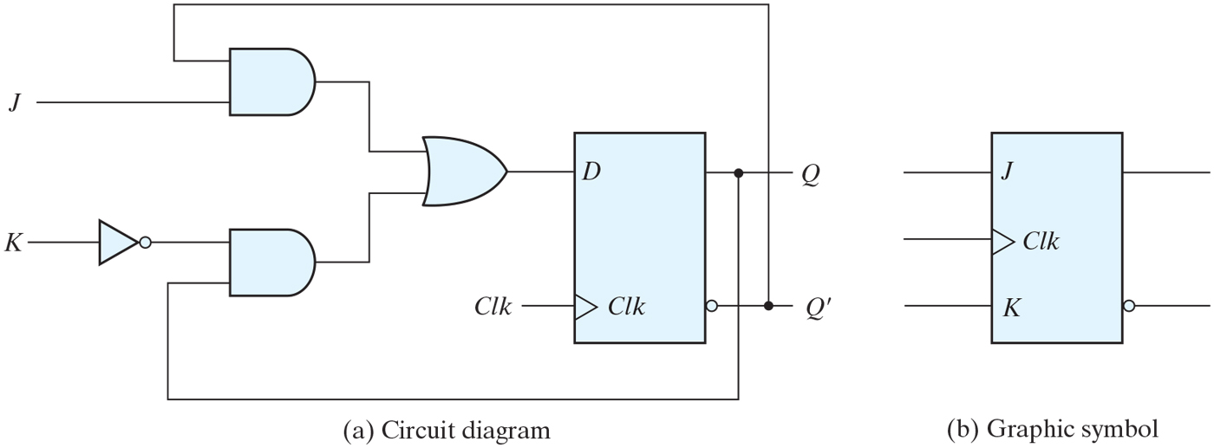
JK flip-flop.

Slide 13
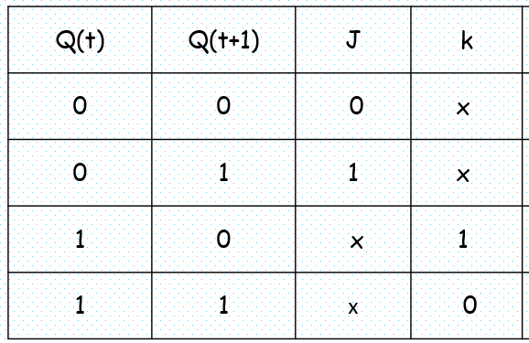
T Flip Flop using JK Flip Flop
T | Q(t) | Q(t+1) | J | K
0 | 0 | 0 | 0 | x
0 | 1 | 1 | x | 0
1 | 0 | 1 | 1 | x
1 | 1 | 0 | x | 1
T
J
Q
J = K = T
C
K

Slide 14
T Flip Flop using D Flip Flop
T | Q(t) | Q(t+1) | D
0 | 0 | 0
0 | 1 | 1
1 | 0 | 1
1 | 1 | 0
T
D
Q
C

Slide 15
Flip-flop Behavior Example
Use the characteristic tables to find the output waveforms for the flip-flop shown:
Clock
D
D
QD
C

Slide 16
Flip-flop Behavior Example
Use the characteristic tables to find the output waveforms for the flip-flops shown:
Clock
T
T
C

Slide 17
Flip-Flop Behavior Example
Use the characteristic tables to find the output waveforms for the flip-flop shown:
Clock
J
K
J
QJK
C
K

Slide 18
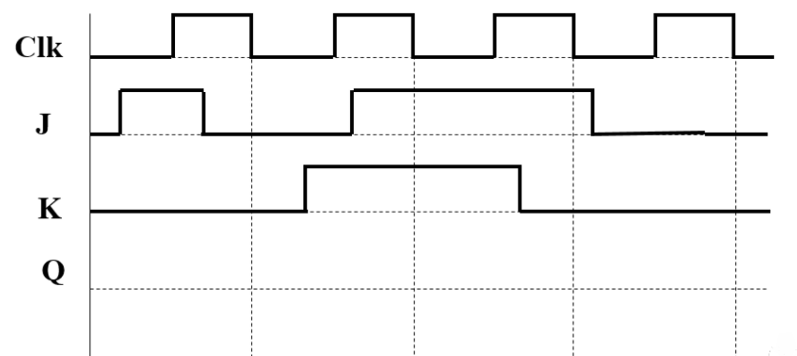
Complete the timing diagram assuming you are using a negative- edge triggered JK flip flop.

